Slide 1
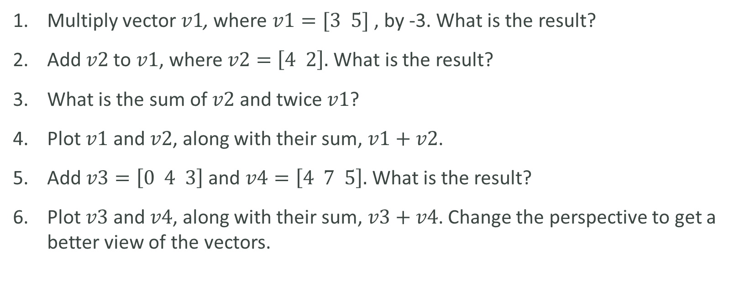
LAB
Multiply vector $v1$, where $v1=[3 5]$ , by -3. What is the result?
Add $v2$ to $v1$, where $v2=\left[4 2\right].$ What is the result?
What is the sum of $v2$ and twice $v1$?
Plot $v1$ and $v2$, along with their sum, $v1+v2$.
Add $v3=\left[0 4 3\right]$ and $v4=\left[4 7 5\right].$ What is the result?
Plot $v3$ and $v4$, along with their sum, $v3+v4$. Change the perspective to get a better view of the vectors.

